Slide 1
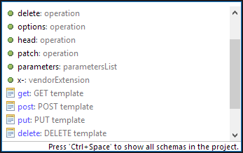
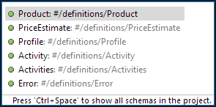
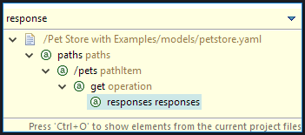
Content Assist
Keyword Suggestion
Template Suggestion
Swagger Reference Properties ($ref keyword)
Cycling: Repeat key combination to cycle file, project & workspace scope
Quick Outline
Type to filter

